Slide 1
Lecture 18
Vision for the Universal Human Order

Slide 2
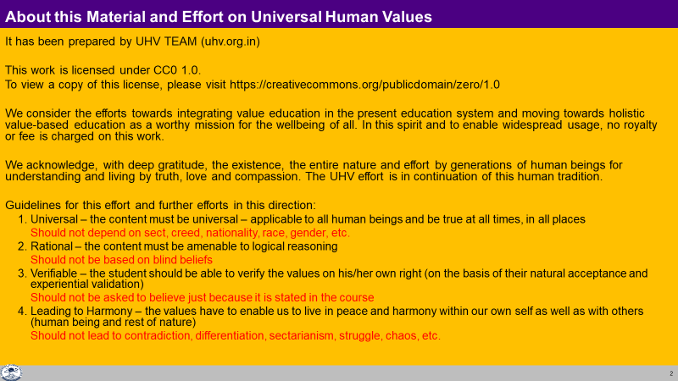

Slide 3
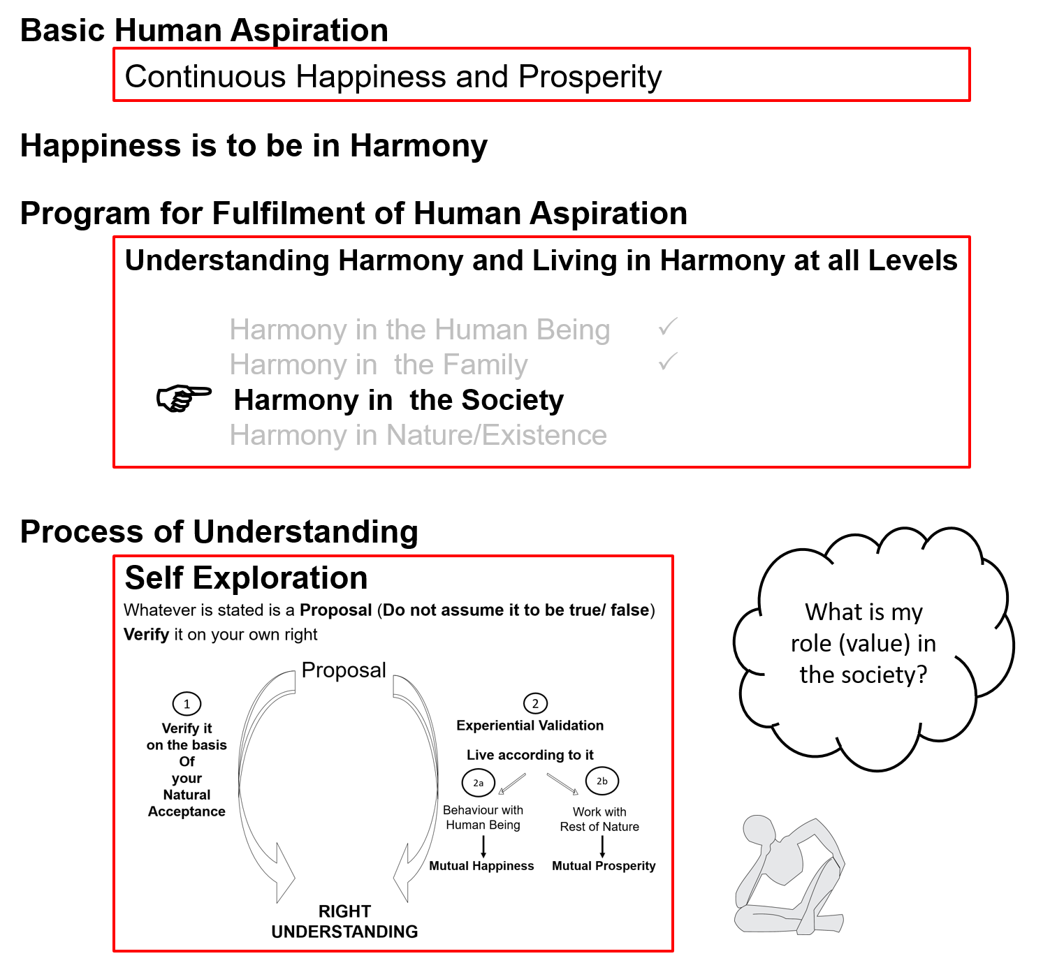

Slide 4
Universal Human Order
We explored:
Goal of human being living in society (human goal)
The dimensions or systems required to achieve the human goal
In this lecture, we will recap these two and discuss the
Scope of the systems
We will also discuss more details of some of the societal systems which will ultimately lead to the universal human order

Slide 5
Harmony in the Society (lekt esa O;oLFkk)
Human Goal (ekuo y{;)
Human Order ¼ekuoh; O;oLFkk½
Systems / Dimensions ¼vk;ke½
  1. Education – Sanskar
  2. Health – Self-regulation
  3. Production – Work
  4. Justice – Preservation
  5. Exchange – Storage
Right Understanding & Right Feeling
Prosperity
Fearlessness
(Trust)
Co-Existence
(mutual fulfilment)
1
Happiness
2
3
4
In Every Individual
In Every Family
In Society
In Nature/ Existence
1
2
3
4
1
2
4
3
4
2
3

Slide 6
Harmony in the Society (lekt esa O;oLFkk)
Human Goal
Human Order ¼ekuoh; O;oLFkk½
Systems / Dimensions ¼vk;ke½
  1. Education – Sanskar
  2. Health – Self-regulation
  3. Production – Work
  4. Justice – Preservation
  5. Exchange – Storage
Right Understanding & Right Feeling
Prosperity
Fearlessness
(Trust)
Co-Existence
(mutual fulfilment)
1
Happiness
In Every Individual
In Every Family
In Society
In Nature/ Existence
1
2
3
4
1a. Education – To develop the right understanding of the harmony at all levels of our being – from self to the entire existence (individual, family, society, nature/existence)
1b. Sanskar – The commitment, preparation and practice of living in harmony. Preparation includes learning the skills and technology for living in harmony at all levels – from self to the entire existence (individual, family, society, nature/existence)
1

Slide 7
Education-Sanskar
Education = Developing Right Understanding
Sanskar = Commitment/ Preparation/ Practice for Right Living
Preparation includes Learning Right Skills & Technology
Development of the competence to live with Definite Human Conduct
Discipline to Self Discipline
Right understanding, i.e. wisdom or clarity about what to do as a human being – in oneself, family, society, nature…
Right feeling – the capacity to live in relationship with the other human beings – in family, society…
Right skills for prosperity, i.e.
    The capacity to identify the need of physical facility
    The skills & practice for sustainable production of more than what is required (by way of labour using cyclic, mutually enriching process)
    The feeling of prosperity

Slide 8
Development – In an environment of Relationship
Assuming ekuuk
Knowing
tkuuk
Imitate vuqdj.k
Family
ifjokj
School
fo|ky;
University
fo”o&fo|ky;
Society
lekt
Follow vuqlj.k
Next Generation
Obedience/Discipline
vkKkikyu@vuq'kklu
Relationship
laca/k
Right
lgh
Self-verif
Tkk¡p
Self Discipline (10…)
Lo&vuq'kklu
Self-confidence
vkRefo”okl
Every next generation is more developed
In harmony within
In harmony with family
In harmony with society
In harmony with nature/existence

Slide 9
“Development” – In an environment of Domination
Imitate vuqdj.k
Family
ifjokj
School
fo|ky;
University
fo”o&fo|ky;
Society
lekt
Assuming ekuuk
Follow vuqlj.k
Next Generation
Obedience/Discipline
vkKkikyu@vuq'kklu
Domination
'kklu
Self-verif
Tkk¡p
Wrong
xyr
Arbitrariness euekuh
Every next generation may be less developed
In more contradiction within
In more opposition with family
More struggle in society
More conflict with nature
Opposition nz®g
Revolt fonz®g (~teenage)
Struggle laÄ‘kZ
War ;q)

Slide 10
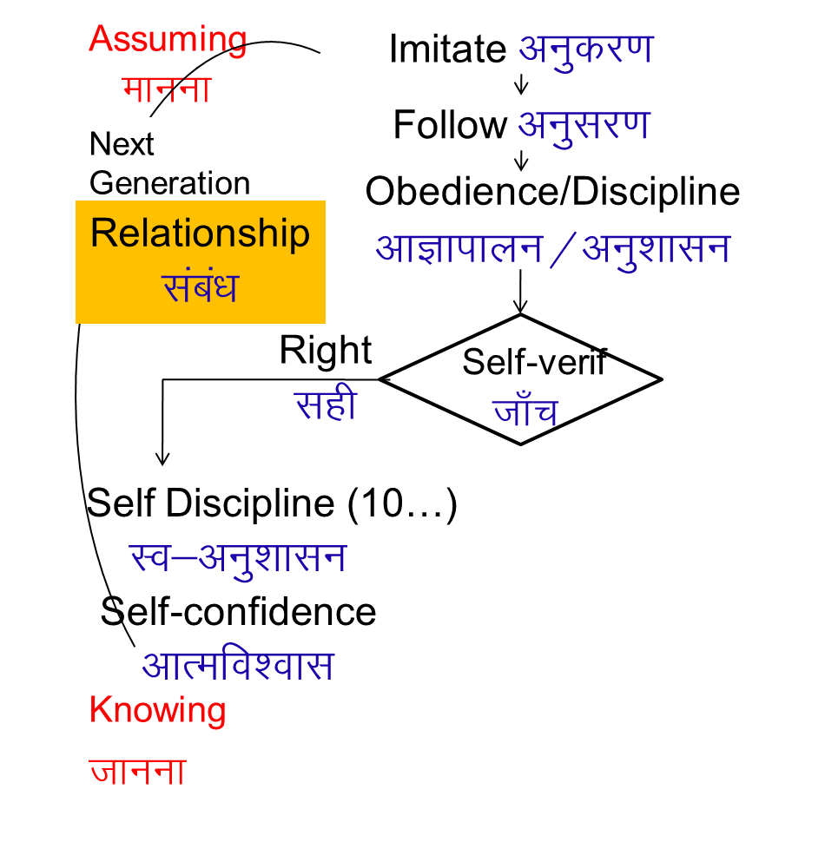
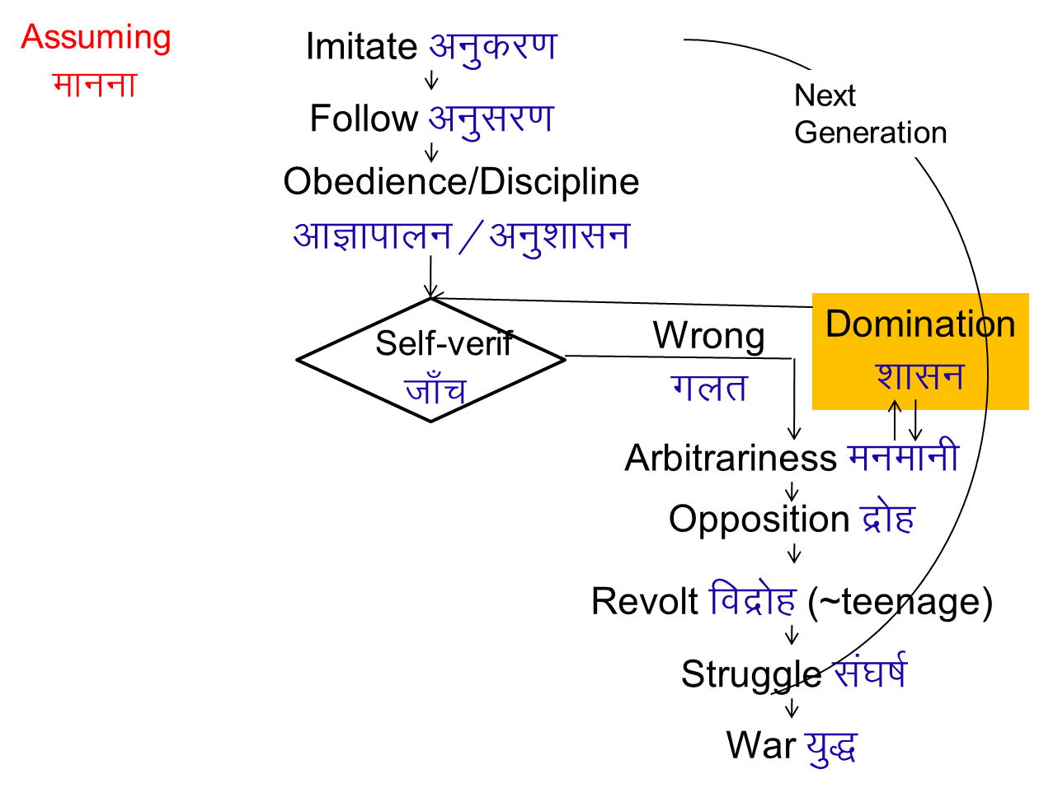

Process of Development – Relationship Process of Development – Domination
In an environment of Relationship
With parents and teachers having right understanding and right feeling
In an environment of Domination
With parents and teachers lacking right understanding and right feeling

Slide 11
आज हम कहाँ हैं? कहाँ होना चाहते हैं? Where are we today? Where do we want to be?
Small Children
Youth,
Adults
In an environment of Relationship
With parents and teachers having
right understanding and right feeling
In an environment of Domination
With parents and teachers lacking
right understanding and right feeling

Slide 12
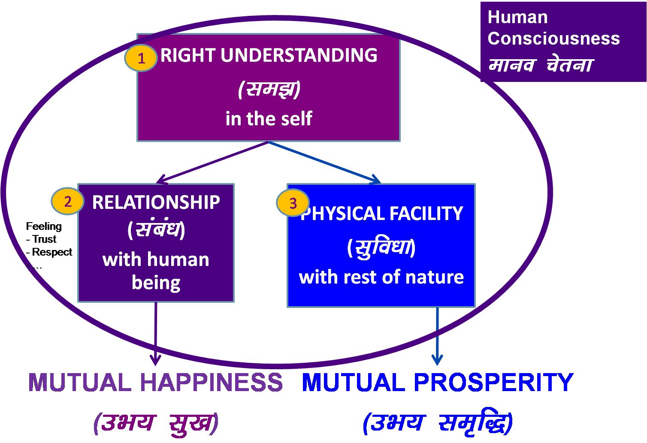
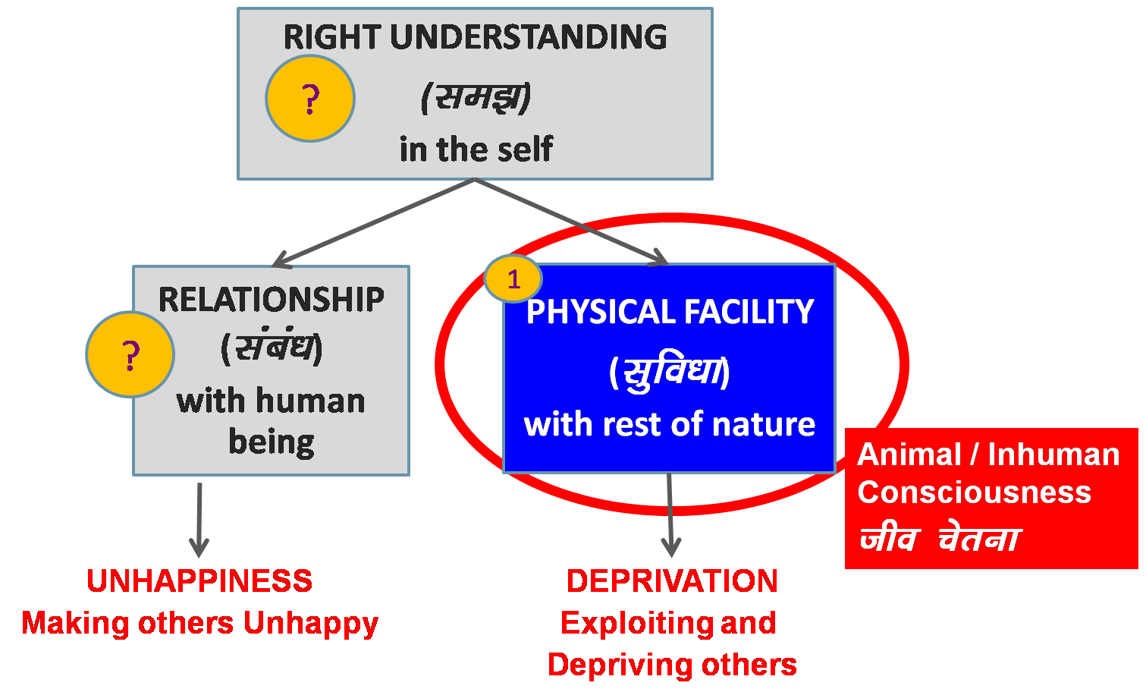
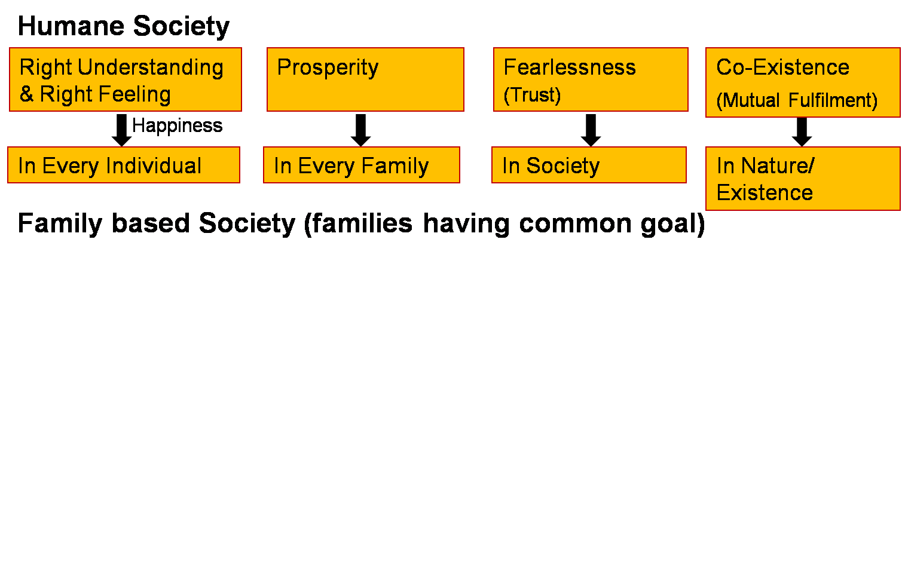
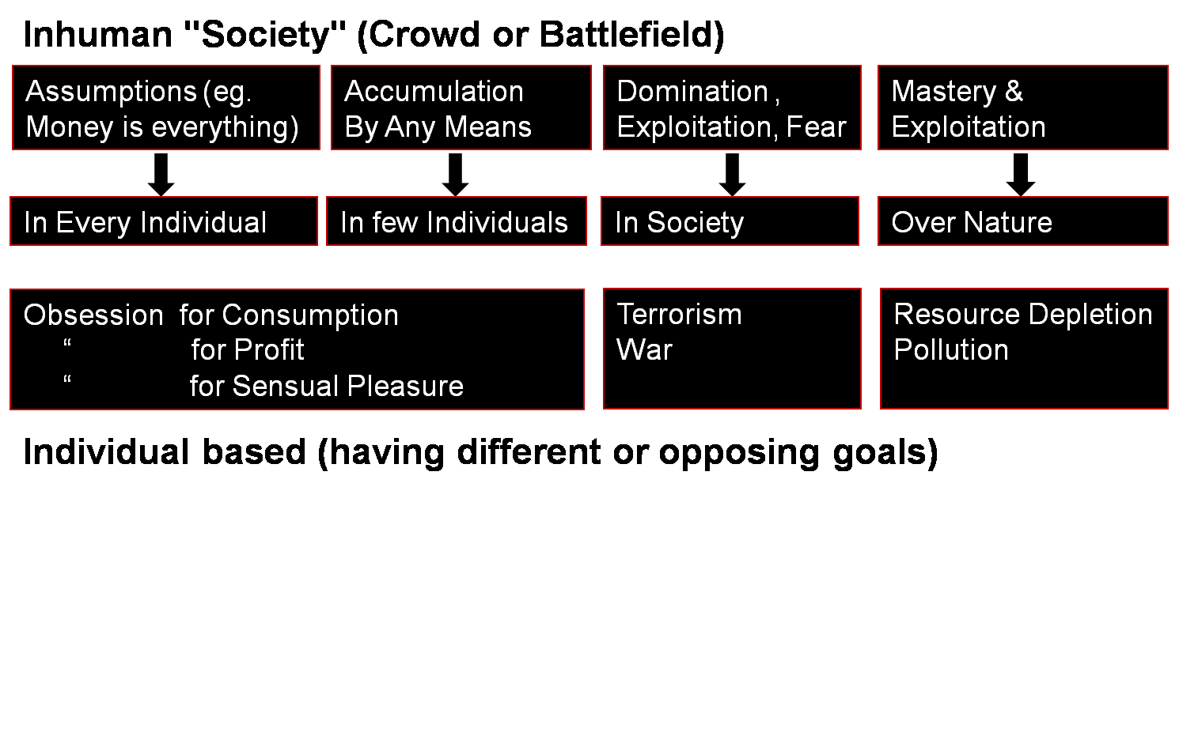
Human Education
Next generation has improved
- Understanding
- Feeling
Human Education
Personal Transformation
Societal Transformation
Transformation& Progress
laØe.k&fodkl

Slide 13
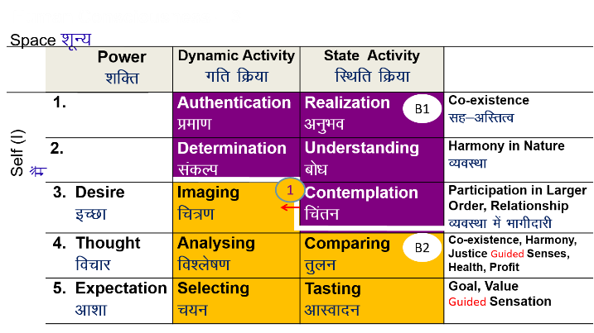
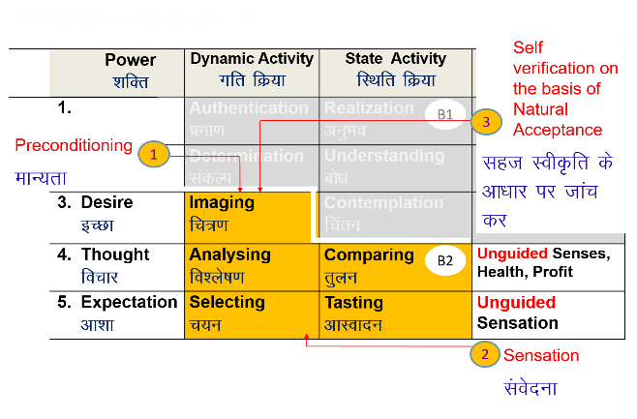
Human Education
Next generation has improved
- Understanding
- Feeling
Human Education
Personal Transformation
Societal Transformation
Transformation& Progress
laØe.k&fodkl

Slide 14
Harmony in the Society (lekt esa O;oLFkk)
Human Goal
Human Order ¼ekuoh; O;oLFkk½
Systems / Dimensions ¼vk;ke½
  1. Education – Sanskar
  2. Health – Self-regulation
  3. Production – Work
  4. Justice – Preservation
  5. Exchange – Storage
Right Understanding & Right Feeling
Prosperity
Fearlessness
(Trust)
Co-Existence
(mutual fulfilment)
Happiness
2
4
In Every Individual
In Every Family
In Society
In Nature/ Existence
1
2
3
4
2b. Self-regulation – Feeling of responsibility for Nurturing, Protection and Right Utilization of the Body
2a. Health (Swasthya) –
  Body acts according to Self (I)
  Parts of the body are in harmony (in order)
→ Recognising What is Needed as Physical Facility
2
4

Slide 15
Program for Health-Self Regulation
(A) For Staying Healthy
1a
  1 Intake and Routine (Lifestyle)
  2 Labour and Exercise
  3 Postures for regulating internal & external body organs and
  Regulated Breathing
  4 Medicine and Treatment
1
1b
2
(B) For bringing body back to harmony from temporary disharmony
3
(C) Dependence on drug / machine to perform a body function

Slide 16
System for Health-Self-regulation at various Levels
Level Program
Individual Lifestyle, exercise
Family Intake, daily routine
Family cluster Postures, Regulation of breath
Village Medicine
Village cluster / city Health education, environment, labour, treatment
…
Nation Proliferation of good practices
…
World Humane culture, civilisation, tradition
More research is required for this societal system / dimension

Slide 17
Harmony in the Society (lekt esa O;oLFkk)
Human Goal
Human Order ¼ekuoh; O;oLFkk½
Systems / Dimensions ¼vk;ke½
  1. Education – Sanskar
  2. Health – Self-regulation
  3. Production – Work
  4. Justice – Preservation
  5. Exchange – Storage
Right Understanding & Right Feeling
Prosperity
Fearlessness
(Trust)
Co-Existence
(mutual fulfilment)
Happiness
2
4
In Every Individual
In Every Family
In Society
In Nature/ Existence
1
2
3
4
2
4
3b. Work: The labour a human being does on the rest of nature
3a. Production: The physical facility obtained out of work

Slide 18
Behaviour Work
With human being
Return of behaviour =
right understanding, right feeling, right thought
Mutual happiness
With rest of nature
Return of work =
physical facility
Mutual prosperity
- Prosperity of human being
- Enrichment, protection and right utilisation (preservation) of rest of nature

Slide 19
Production
1. Primary production of physical facility used for nurturing, protection & right utilisation of body
eg. Food, clothes, shelter…
2. Secondary Production of physical facility used to facilitate primary production
eg. Tractor…
3. Tertiary Production of physical facility used to facilitate production, services & behaviour
eg. Train, TV, Mobile…
4. Services to facilitate any of the above production
eg. Tractor maintenance, software for mobile
Priority order = 1, 2, 3, 4? Or 4, 3, 2, 1?

Slide 20
Harmony in the Society (lekt esa O;oLFkk)
Human Goal
Human Order ¼ekuoh; O;oLFkk½
Systems / Dimensions ¼vk;ke½
  1. Education – Sanskar
  2. Health – Self-regulation
  3. Production – Work
  4. Justice – Preservation
  5. Exchange – Storage
Right Understanding & Right Feeling
Prosperity
Fearlessness
(Trust)
Co-Existence
(mutual fulfilment)
Happiness
3
In Every Individual
In Every Family
In Society
In Nature/ Existence
1
2
3
4
4a. Justice – Recognition of Human-Human Relationship, its Fulfillment & Evaluation leading to Mutual Happiness
3
Notes:
* U;k; lqj{kk& f}rh; egRoiw.kZ vk;ke
U;k;¾ekuo&ekuo laca/k dh igpku] fuokZg]mHk; lq[k
lqj{kk¾ekuo&”ks’k izd`fr laca/k dh igpku] fuokZg]mHk; le`f)
U;k; lqj{kk dh ftEesnkjh gj O;fDr dh gS] ifjokj dh gS] lekt dh gS vkSj varr% jkT; dh gSA
lekt o jkT; esa U;k; lqj{kk dks lqfuf”pr djus dh ftEesnkjh “kklu&iz”kklu dh gSA
jkT; esa vxj U;k;] lqj{kk dh lqfuf”prrk u gks ik;] vogsyuk gks] foijhr gks rks
ml vU;k;] vlqj{kk dks jksdus dh ftEesnkjh U;k;ikfydk o iqfyl dh gSA
U;k; lqj{kk dks lqfuf”pr djus esa “kklu&iz”kklu dk lg;ksx djus dh ftEesnkjh iqfyl dh gSA
U;k; D;k gS\&bls le>uk vko”;d gSA&laca/k] Hkko ewY;&fo”okl] lEeku
lqj{kk D;k gS\ &ijLijiwjdrk
D;k gesa U;k; dh Li’Vrk gS\
D;k ge U;k;iwoZd th jgs gS &Lo;a esa lgh Hkko gS
ifjokj esa lgh Hkko gS] mldk fuokZg dj mHk; lq[k gks jgk gS
fe=ksa esa] lgdfeZ;ksa esa lgh Hkko gS] mldk fuokZg dj mHk; lq[k gks jgk gS
&lekt esa U;k;iwoZd th ik jgs gSa\
&lekt esa vU;k; dks jksd ik jgs gSa\
;gh lc iz”u lqj{kk dks ysdj Hkh gSaA

Slide 21
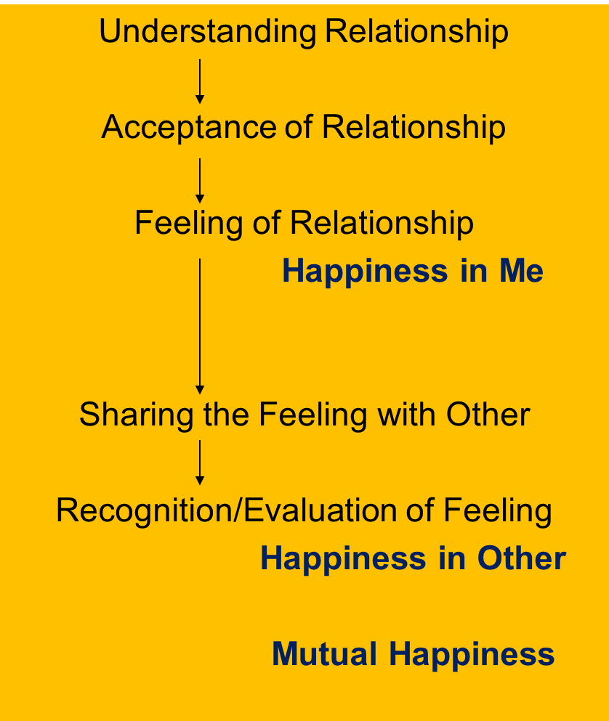
Harmony in Family – Justice, From Family to World Family (Undivided Society)
Relationship is – between one self (I₁) and other self (I₂)
There are feelings in relationship – in one self (I₁) for other self (I₂)
These feelings can be recognized – they are definite (9 Feelings)
Their fulfilment, evaluation leads to mutual happiness
Feelings in relationship:
Justice = Recognition, Fulfillment & Evaluation of
Human-Human Relationship, leading to Mutual Happiness
Justice → from Family to World Family
→ Undivided Society ¼v[k.M lekt½
1- Trust fo”okl FOUNDATION VALUE
2- Respect lEeku
3- Affection Lusg
4- Care eerk
5- Guidance okRlY;
6- Reverence J)k
7- Glory xkSjo
8- Gratitude —rKrk
9- Love izse COMPLETE VALUE

Slide 22
Self Reflection
What is required for justice in the society? At each level
Family level… neighborhood… institution… city… district… state… nation… world
Like that, clarity of the base as well as details are essential for a humane society to materialize
Most importantly, our meaningful participation in one or more societal systems / dimensions is expected

Slide 23
Harmony in the Society (lekt esa O;oLFkk)
Human Goal
Human Order ¼ekuoh; O;oLFkk½
Systems / Dimensions ¼vk;ke½
  1. Education – Sanskar
  2. Health – Self-regulation
  3. Production – Work
  4. Justice – Preservation
  5. Exchange – Storage
Right Understanding & Right Feeling
Prosperity
Fearlessness
(Trust)
Co-Existence
(mutual fulfilment)
Happiness
4
In Every Individual
In Every Family
In Society
In Nature/ Existence
1
2
3
4
4b. Preservation – Recognition of Human-Rest of Nature Relationship, its Fulfillment & Evaluation leading to Mutual Prosperity or Mutual Enrichment
Prosperity of Human Being
Enrichment, Protection & Right Utilisation of rest of Nature
4

Slide 24
Harmony in the Society (lekt esa O;oLFkk)
Human Goal
Human Order ¼ekuoh; O;oLFkk½
Systems / Dimensions ¼vk;ke½
  1. Education – Sanskar
  2. Health – Self-regulation
  3. Production – Work
  4. Justice – Preservation
  5. Exchange – Storage
Right Understanding & Right Feeling
Prosperity
Fearlessness
(Trust)
Co-Existence
(mutual fulfilment)
Happiness
2
3
In Every Individual
In Every Family
In Society
In Nature/ Existence
1
2
3
4
5a. Exchange – of physical facility with a view of mutual fulfillment
(not with obsession for profit / of exploitation)
5b. Storage – of physical facility with a view of mutual fulfillment
(not with obsession for profit / of accumulation)
2
3

Slide 25
Developmental Economics = ?
Take-Take Economics (dominate/exploit HB, exploit rest of nature)
Feeling: opposition
Result: both try to maximise their share (profit maximisation)
Needs are undefined / unlimited + resources are limited → Everyone is bound to be deprived
Give-Take Economics
Feeling: indifferent or opposition
Give-Give Economics (both work for mutual fulfilment and enrichment)
Feeling: Relationship
1. Identify the needs → Needs are definite
2. Produce more than what is required by cyclic, mutually enriching process
(more is for sharing in relationship, for order in the society)
→ Resources are more than required
Every family (all) can be prosperous

Slide 26
Harmony in the Society (lekt esa O;oLFkk)
Human Goal (ekuo y{;)
Human Order ¼ekuoh; O;oLFkk½
Systems / Dimensions ¼vk;ke½
  1. Education – Sanskar
  2. Health – Self-regulation
  3. Production – Work
  4. Justice – Preservation
  5. Exchange – Storage
Right Understanding & Right Feeling
Prosperity
Fearlessness
(Trust)
Co-Existence
(mutual fulfilment)
1
Happiness
2
3
4
In Every Individual
In Every Family
In Society
In Nature/ Existence
1
2
3
4
1
2
4
3
4
2
3

Slide 27
Harmony in Society – Universal Human Order
Human Goal (ekuo y{;)
Systems / Dimensions of Human Order ¼ekuoh; O;oLFkk& vk;ke½
  1. Education – Sanskar - f”k{kk laLdkj
  2. Health – Self-regulation - LokLF; la;e
  3. Production – Work - mRiknu dk;Z
  4. Justice – Preservation - U;k; lqj{kk
  5. Exchange – Storage - fofue; dks’k
Scope –From Family Order to World Family Order (Universal Human Order)
Family – Family cluster – Village – Village cluster ... Nation ... World Family
Order Order Order Order Order Order
~10¹ ~10² ~10¹⁰
Right Understanding & Right Feeling
Prosperity
Fearlessness
(Trust)
Co-Existence
(mutual fulfilment)
Happiness
In Every Individual
In Every Family
In Society
In Nature/ Existence

Slide 28
Scope Example in India Education Health Justice Production etc.
Individual 131 Crore (2020) Individuals with right understanding, right feeling and thought
responsible for oneself and participate meaningfully
in the larger order
1-Family 25 Crore families Families of happy individuals work for common family goal,
ensure mutual happiness and prosperity in family
2-Family Cluster Happy and prosperous families work for common societal goal
3-Village 7 Lakh villages Crucial for societal harmony
Large% of needs, goals fulfilled at the village level
Smaller% of the needs, goals to be fulfilled by higher levels
4-City / Village Cluster
5-Region
6-Mandal
7-Mandal Cluster
8-State
9-Nation Nation is in harmony and
Nation participates in ensuring harmony with other nations
10-World Humane society: undivided family (feeling of relationship in all, for all)
& universal human order (human goal is fulfilled for all gen after gen)

Slide 29
Scope: Example in Bhutan 2016
Individual 7.8 lakhs
1-Family 56,000 households
2-Village 4,500
Thromdes (muncipality)
3-Chiwog (village cluster) 1,044
4-Gewog (village block) 205 (avg. 230 km² / Gewog)
Dunkhag (sub district)
5-Dzongkhag (district) 20
6-Nation Family 1
World Family

Slide 30
Sum Up
A society is composed of families living together, in a relationship of mutual fulfillment. They have a common goal, which is:
    Right understanding & right feeling (happiness) in every individual
    Prosperity in every family
    Fearlessness (trust) in society
    Co-existence (mutual fulfilment) in nature/existence
The family is the basic unit in society, i.e. society is composed of family, group of families, village family, group of village families, town family… and so on, where every individual is responsible or self-disciplined and self motivated by common values, participating in the larger order toward a common human goal
Through the participation of every family in the society, in the 5 dimensions or social systems, the common human goal is fulfilled for all
    – from family order to world family order
    – generation after generation
[the current civilization is largely based on the assumption that human being = body, happiness is derived primarily from sensual pleasure & feeling from other; and hence accumulation of physical facility, domination and exploitation is at the core of the socio-economic systems]
1. Education – Sanskar
2. Health – Self-regulation
3. Production – Work
4. Justice – Preservation
5. Exchange – Storage

Slide 31
Harmony in the Society – Universal Human Order
Human Goal
(ekuo y{;)
Human Order ¼ekuoh; O;oLFkk½
Systems / Dimensions ¼vk;ke½
  1. Education – Sanskar
  2. Health – Self-regulation
  3. Production – Work
  4. Justice – Preservation
  5. Exchange – Storage
Scope –From Family Order to World Family Order (Universal Human Order)
Family – Family cluster – Village – Village cluster/city ... Nation ... World Family
Order Order Order Order Order Order
~10¹ ~10² ~10¹⁰
Right Understanding & Right Feeling
Prosperity
Fearlessness
(Trust)
Co-Existence
(mutual fulfilment)
Happiness
In Every Individual
In Every Family
In Society
In Nature/ Existence

Slide 32
Self Reflection

Slide 33
Self Reflection
What is the common goal of your family? Is achieving it discussed periodically? How does it map to the Human Goal?
In your family, sit together and discuss
  the family goal
  the program for its fulfillment
  the role / participation of each of the family members in its fulfillment
  the state of the fulfillment of the goal (evaluation)

Slide 34
Self Reflection
What is the common goal of the organization you belong to? How does it map to the Human Goal?
How can you and your organization contribute for ensuring right understanding and right feeling in the neighborhood of the institution?

Slide 35
Key Points
Lecture 18: Vision for the Universal Human Order

Slide 37
Harmony in Society – Universal Human Order
Human Goal (ekuo y{;)
Systems / Dimensions of Human Order ¼ekuoh; O;oLFkk& vk;ke½
  1. Education – Sanskar - f”k{kk laLdkj
  2. Health – Self-regulation - LokLF; la;e
  3. Production – Work - mRiknu dk;Z
  4. Justice – Preservation - U;k; lqj{kk
  5. Exchange – Storage - fofue; dks’k
Scope –From Family Order to World Family Order (Universal Human Order)
Family – Family cluster – Village – Village cluster ... Nation ... World Family
Order Order Order Order Order Order
~10¹ ~10² ~10¹⁰
Right Understanding & Right Feeling
Prosperity
Fearlessness
(Trust)
Co-Existence
(mutual fulfilment)
Happiness
In Every Individual
In Every Family
In Society
In Nature/ Existence

Slide 38
Sum Up
A society is composed of families living together, in a relationship of mutual fulfillment. They have a common goal, which is:
    Right understanding & right feeling (happiness) in every individual
    Prosperity in every family
    Fearlessness (trust) in society
    Co-existence (mutual fulfilment) in nature/existence
The family is the basic unit in society, i.e. society is composed of family, group of families, village family, group of village families, town family… and so on, where every individual is responsible or self-disciplined and self motivated by common values, participating in the larger order toward a common human goal
Through the participation of every family in the society, in the 5 dimensions or social systems, the common human goal is fulfilled for all
    – from family order to world family order
    – generation after generation
[the current civilization is largely based on the assumption that human being = body, happiness is derived primarily from sensual pleasure & feeling from other; and hence accumulation of physical facility, domination and exploitation is at the core of the socio-economic systems]
1. Education – Sanskar
2. Health – Self-regulation
3. Production – Work
4. Justice – Preservation
5. Exchange – Storage

Slide 39
FAQs for Lecture 18
Vision for the Universal Human Order

Slide 40
Question(s): Response
What is the right age to start value education? I am asking because children don't have the capacity to think so deeply and evaluate all these proposals. Is there a different process of learning for adults and a different process for children?
For a child to live with definite human conduct, the parents need to have right understanding so that they are able to give the right sanskar to the child. Thus the preparation for educating the child can start before it took birth.
Since childhood, the children are observing their parents, and getting conditioned or educated. Hence, value education has already started.
The process is the same for all: self-exploration. And with children, we get very straightforward answers.

Slide 41
Child’s Desire / Expectation Fulfillment / Satisfaction Point
Expectation for justice
(न्याय का याचक)
    In every interaction
2. Desire for right work & behaviour
(सही कार्य व्यवहार का इच्छुक)
    The child naturally wants to participate, makes effort to learn & can learn
Speaks the truth
(सत्यवक्ता)
    The child naturally speaks whatever truth it knows
    It willingly makes effort to understand, asks lots of questions
    It can understand
    Ability to do justice
    (न्यायप्रदाई क्षमता)
    Competence for right work & behaviour
    (सही कार्य व्यवहार करने कि योग्यता)
    Understanding the truth
    (सत्यबोध)
    from self to entire existence
    The child expects parents, elders, teachers, society… to facilitate it to attain the satisfaction point (role of education-sanskar)

Slide 42
Question(s): Response
Are we talking about having equal physical facilities for all? Or is it that I can have a different need and someone else can have a different need? After all, we have to calculate the amount of money required for living and all kinds of emergencies.
We are not talking about having equal physical facilities. We are talking about the feeling of prosperity. And for that everyone needs to make out the need for physical facility clearly.
To make out the need for physical facilities, we need to understand clearly the needs of self and body.

Slide 43
Question(s): Response
There are so many problems in the society, and our effort will take a long time to make an impact in the society. Don’t you think that a revolution is required?
There are four things:
1. Clarity of all-encompassing solution (samadhan)
2. Effort to materialize the solution
3. Appraisal of the current state of problems
4. Effort to remove the problems.
Many a times, we start from 3 and go for 4 without working for 1 and 2. And then we may create more problems than solutions.
We first need to fix our program for realizing the human goal. In that process, we will be in a better position to evaluate the current state and work to remove the current problems.

Slide 44
Question(s): Response
There is so much disparity today in the society. There is a vast gap between haves and have-not’s. How does this proposal seem to address this gap?
We need to understand that the basic aspiration is continuity of happiness and prosperity. And this is ensured by right understanding and right feelings. It is not determined by the possession of physical facilities.
So whether one belongs to the category of haves or have-not’s, what essentially matter is the correct recognition of need for physical facilities which is possible through right understanding and right feeling.

Slide 45
Question(s): Response
At one point of time, we were living peacefully in our country. And then were invaded from outside the country, and got enslaved. Even if we are able to make this program effective, what is the guarantee that this will not happen again?
We are talking about undivided society. We discussed the steps for self-organization of world family. And when the content of education is universal, it is going to be accepted by all.

Slide 46
Question(s): Response
How do we plan to transition from value education to value based education?
To have value based education, we need to base the content in every course on right understanding and right feeling.
In the present system, there are several modes available. We can redefine the graduate attributes in our courses. At the level of institution, we can set a holistic vision and mission, and so on.

